Slide 1
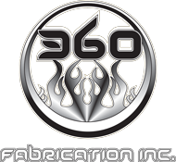

Restoration, Upholstery And Custom Builds

Slide 2
360 Fabrication is one of Canada’s leaders in automotive upholstery, convertible tops, boat upholstery, customized commercial upholstery and airplane and helicopter upholstery repairs, new installation, and custom application. We have designed and built hundreds of award-winning custom projects and our in-house team of top upholstery techs can take on any job large or small and complete it on time and on budget.
360 Fabrication Inc. has won thousands of awards throughout North America. These include many Best in Show, Best Paint, Best Design, Best Custom Interior, Best Sound System

Slide 3
Our Story
With over 70 years of combined experience; the owners and brothers Rick and Daryl Francoeur have been creating and customizing anything with wheels (and some things without). Starting in 2006 they opened 360 Fabrication, which has now grown into Canada's top hot rod and custom shop.
In 2008, with the acquisition of the new 22,000 sq. ft building, the 360 Group of Companies expanded to include:
a car and marine audio department
a custom upholstery shop
a full-service mechanical division
state-of-the-art collision and glass repair facility, 360 Collision Centre

Slide 4
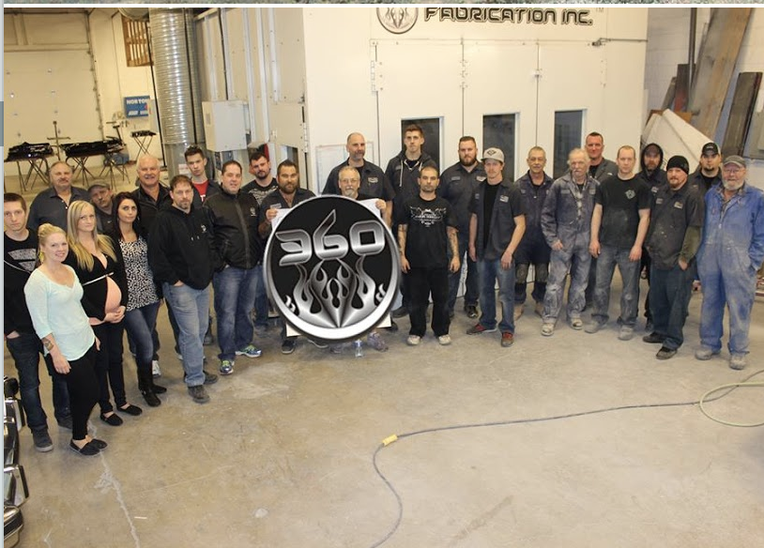
Aviation
Our in house, certified aviation division provides custom-designed interior refurbishing, soundproofing systems, seat structures for the aviation industry.
Airplane & Helicopter Upholstery
Seating & Upholstery
Custom Repairs & Refurbishing
Interiors of Private Jets & Helicopters
Whatever your interior and upholstery project is, 360 Fabrication develops custom upholstery solutions, meets your deadlines and budget and tackles the most challenging projects.

Slide 5
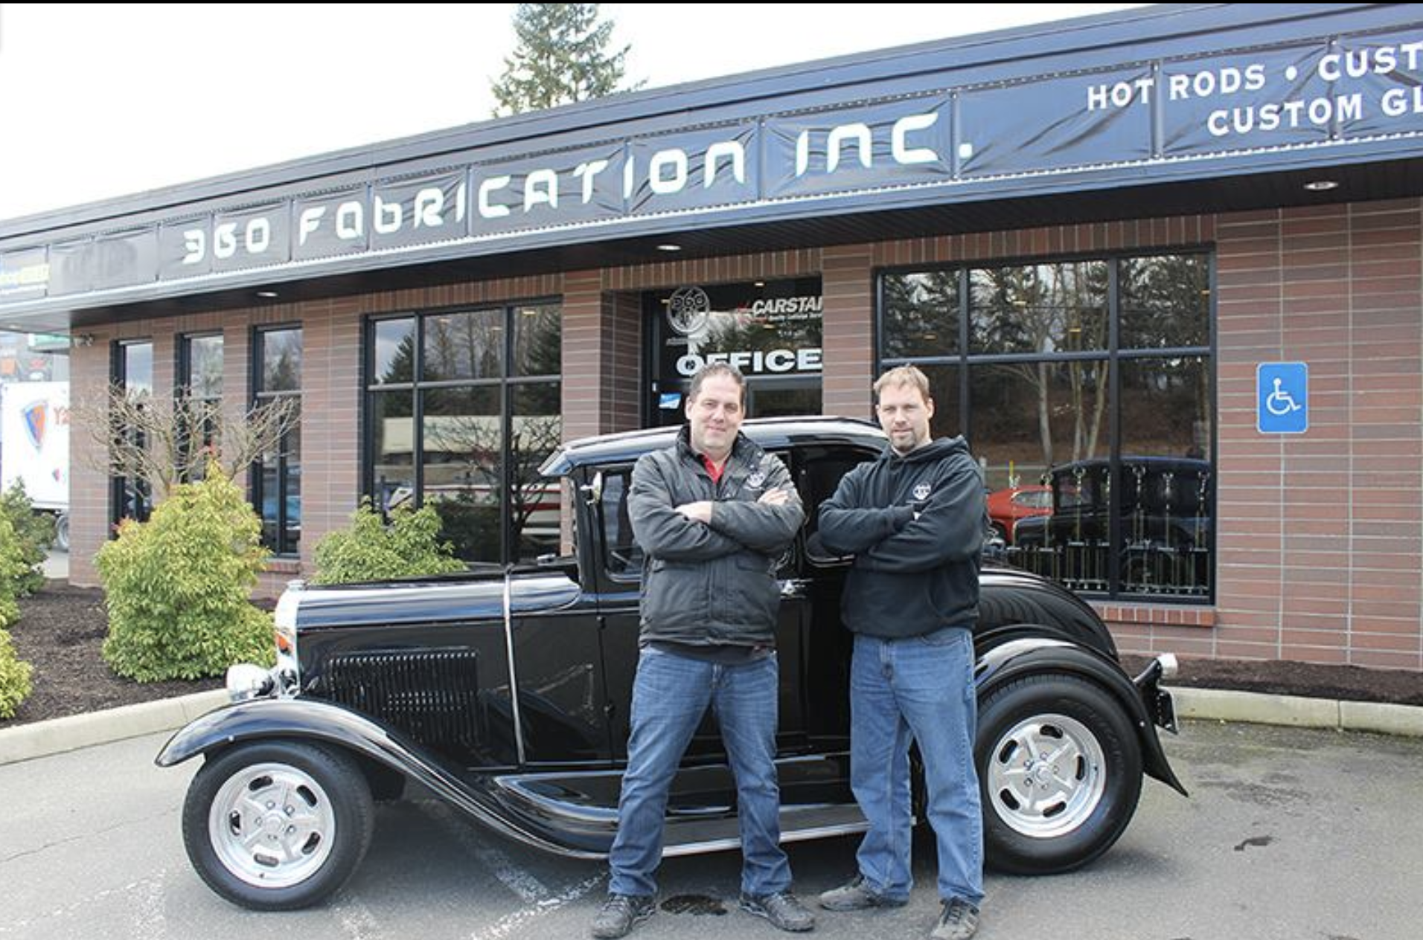
Contact Info
31450 Peardonville Road
Abbotsford BC, V2T 6L1 CANADA
Phone: 604-859-3608
Toll free: 1-855-859-3608
Fax: 604-859-3604
Email: info@360fabrication.com
Web: www.360fabrication.com

